Slide 1
Predicting Ethereum
A study into the future value of Cryptocurrency
John Neville
Regis University

Slide 2

What is Ether?

Slide 3
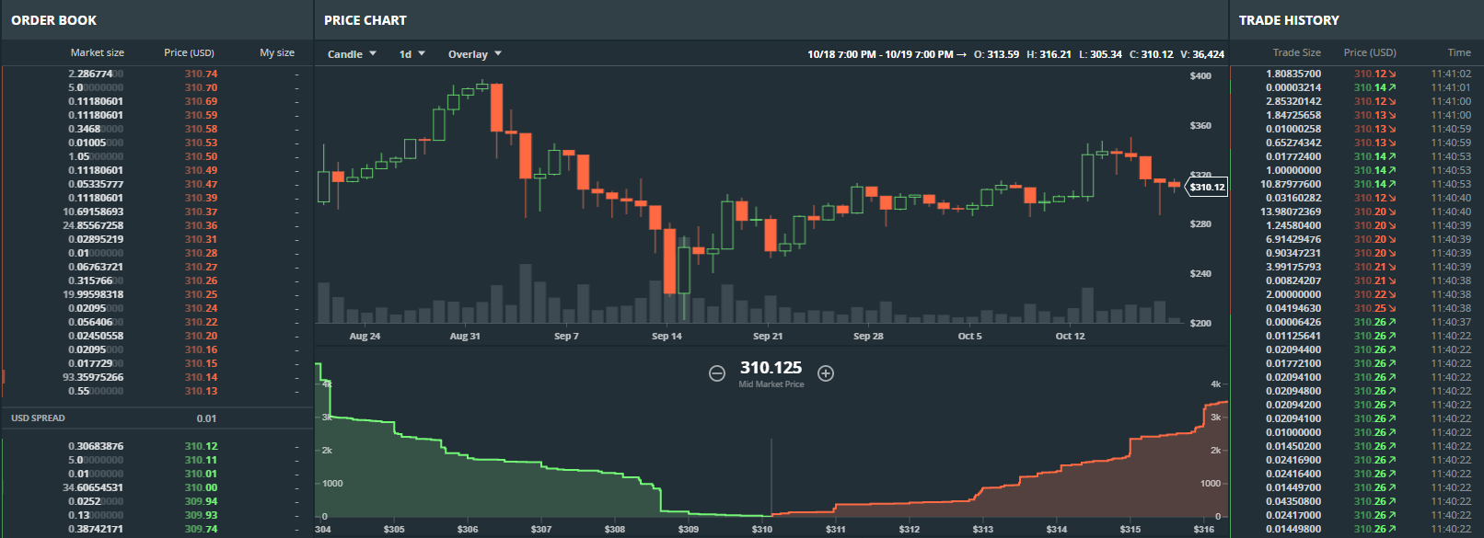
How do you determine the value of Etheruem?
https://www.gdax.com/trade/ETH-USD

